Slide 1
Financial Analytics
Analyzing Competition among Top 500 Companies in India
BY,
KALAIVANI LAKSHMANAN

Slide 2
Objective
Financial analytics provides differing perspectives on the financial data of a given business, giving insights that can facilitate strategic decisions and actions that improve the overall performance of the business.

Slide 3
Problem Statement
Analyze the competition for the management to provide better results.
This data set has information on the market capitalization of the top 500 companies in India.
This dataset contains information such as Serial Number, Name of the Company, Mar Cap – Crore(Market Capitalization in Crores), Sales Qtr – Crore(Quarterly Sale in crores).
Find key metrics and factors and show the meaningful relationships between attributes.

Slide 4
Approach
Used Python for data analysis.
Used Tableau for data visualization.

Slide 5
Quick Insights from cleaned dataset
Total Market Capitalization – 11,424,854 Crores
Total Quarterly Sales – 1,604,532 Crores
Number of Companies – 365 Companies

Slide 6
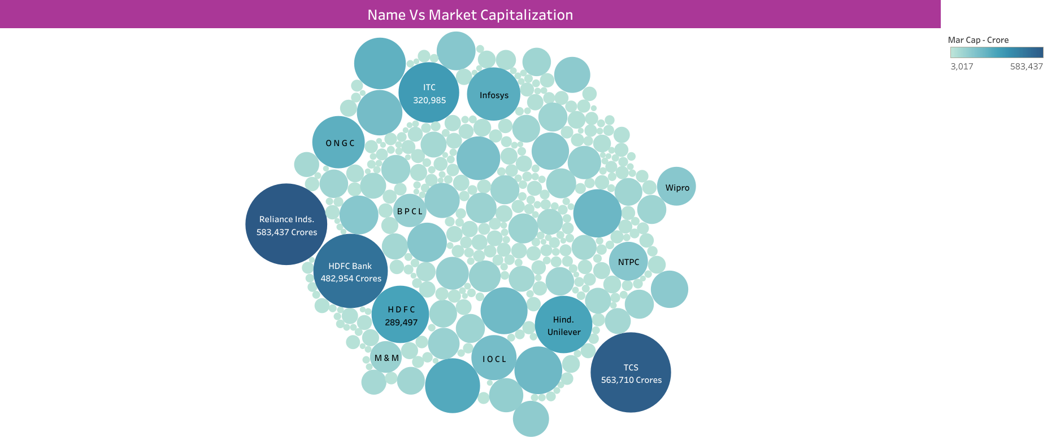
Market Capitalization of Companies

Slide 7
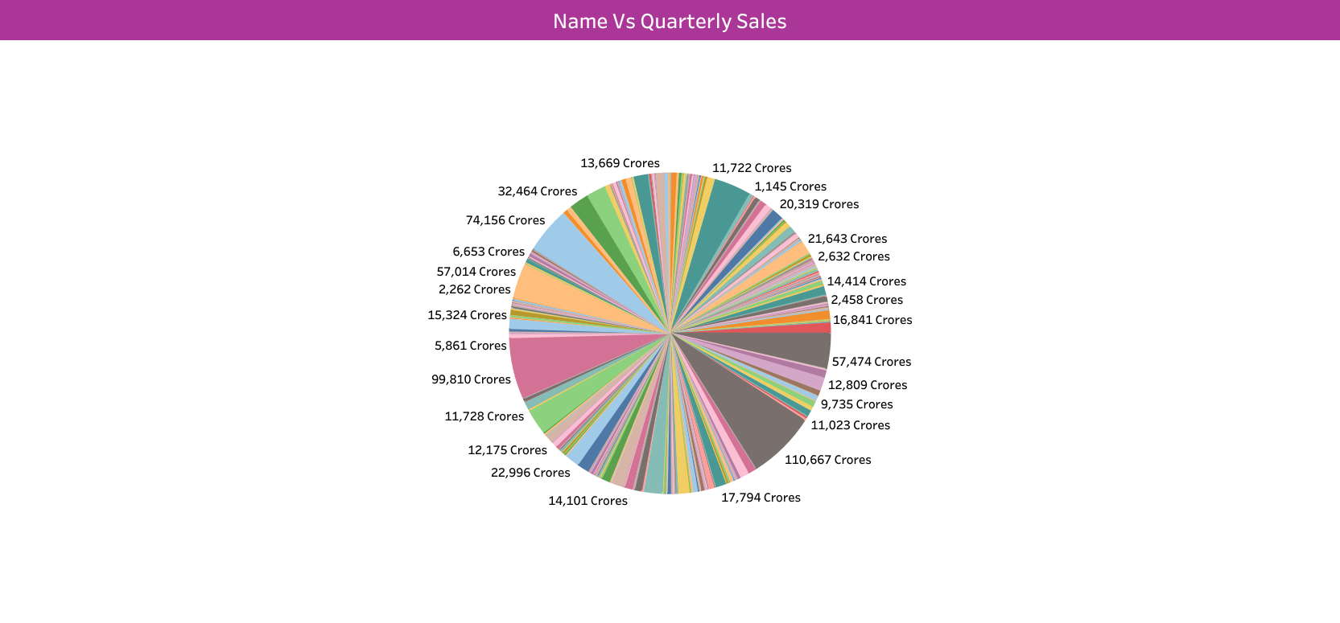
Quarterly Sales of Companies

Slide 8
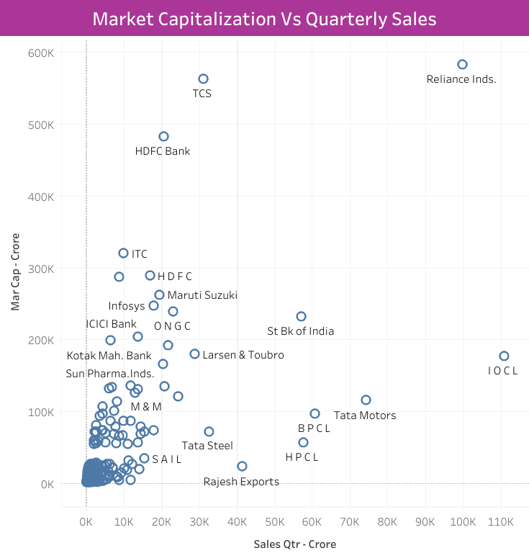

Slide 9
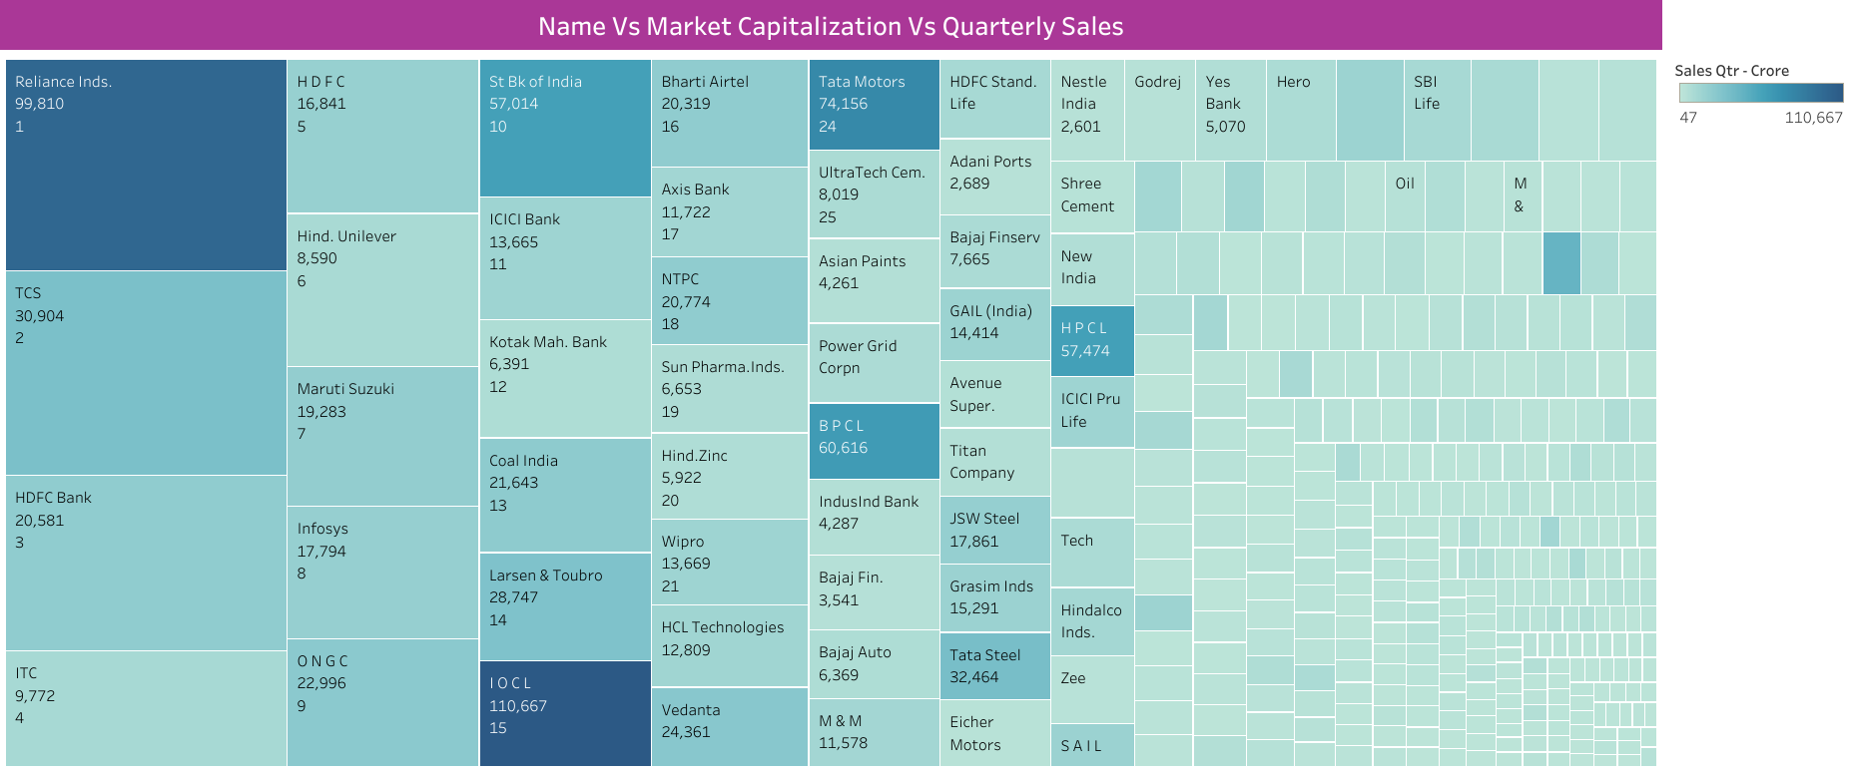

Slide 10
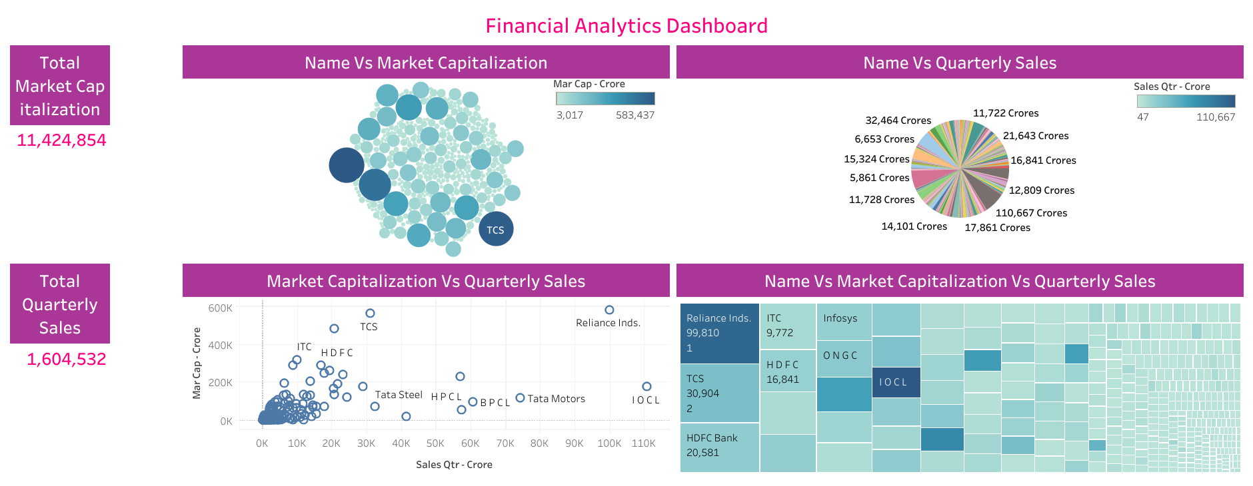

Slide 11
Conclusion Key Findings from the Analysis
Reliance Inds Company have highest Market Capitalization - 583,437 Crores and Natl Fertilizer Company have lowest Market Capitalization – 3017 Crores.
IOCL Company have highest Quarterly Sales – 110,667 Crores and Central Dep. Ser Company have lowest Quarterly Sales – 47.24 Crores.

Slide 12
Thank YOU

